Slide 1

Professional Practice
Software Team Management

Slide 2
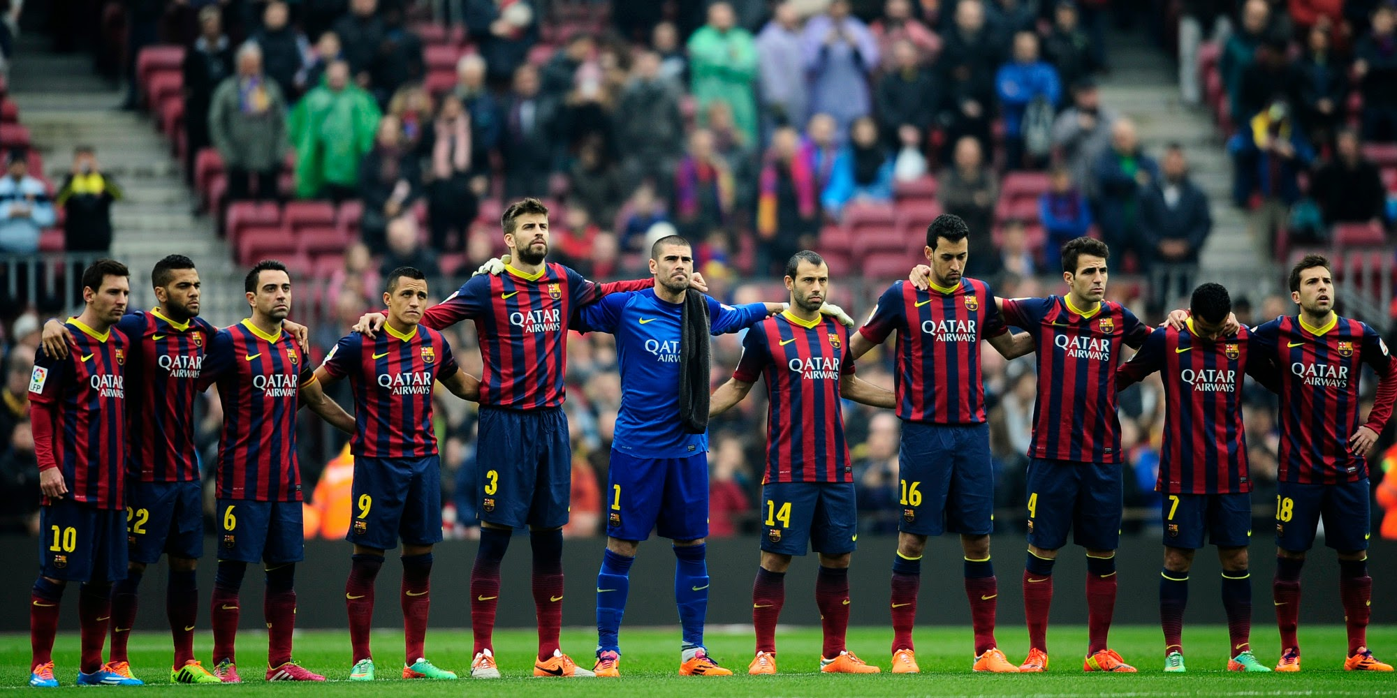
Software House Team

Slide 3

What is A Team??
A team is a number of persons associated together in work or activity: as a group on one side (as in football).
When one person cannot accomplish a job alone and several individuals must cooperate to fulfill a mission or task, you need a team.
The better the cooperation, communication, and coordination among team members, the more efficient the team

Slide 4
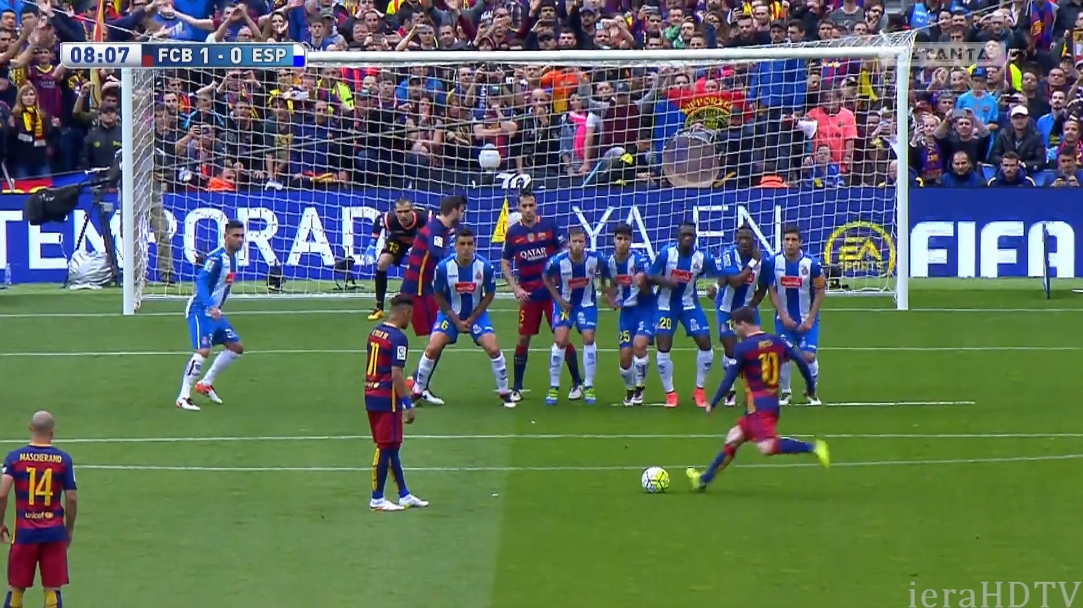
What is Team Management??
Team management refers to techniques, processes and tools for organizing and manage a group of individuals working towards a common goal.

Slide 5
What is Team Management??
Team management is the ability of an individual or an organization to administrate and coordinate a group of individuals to perform a task.
The administration of a group of people assembled to work on a particular project or to perform a particular function within an organization.
Team management involves teamwork, communication, objective setting and performance etc.
Team management is the capability to identify problems and resolve conflicts within a team.

Slide 6
The 4 C’s of Team Management
Competence: Possession of sufficient knowledge or skill
Character: Mental and Ethical traits
Communication: Information Exchange, for Expressing Ideas
Collaboration: To work jointly with others or together

Slide 7
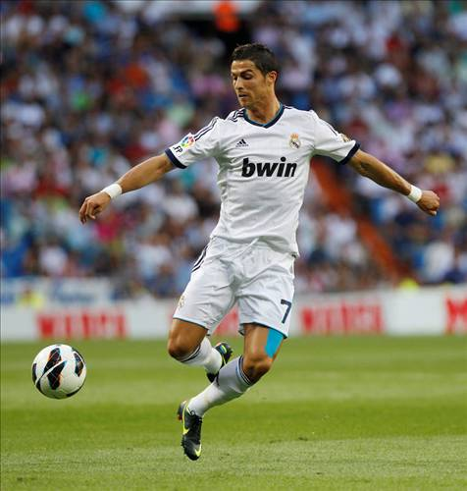
Elements of a Healthy and Successful Team
Cohesive Leadership:
Cohesive leadership means that team leaders are acting
together as a unit and making decisions as a leadership
team instead of each branching off into their own work
and operating individually.
This will ensure that the team will be steered in one
direction instead of multiple due to team leaders not
being concise and consistent with their instructions.

Slide 8
Elements of a healthy and successful team
Common Goal
When team members first come together they will all have different ideas, however the key to a successful team is the alignment of objectives within the team.
It is essential that the team leader sets a common goal the entire team is willing to pursue.
This way, all the team members will put in effort in order to attain the goal. If there is not a common goal, team members who disagree with the objective in hand will feel reluctant to utilize their full effort, leading to failure to achieve the goal. In other cases, team members might divert themselves to other tasks due to a lack of belief or interest in the goal

Slide 9
Elements of a healthy and successful team
Defined team roles and responsibilities
Poorly defined roles is often the biggest obstacle to a successful team.
If team members are unclear of what their role is, their contributions towards the team will be minimal, therefore it is the team leader’s duty to outline the roles and responsibilities of each individual within the team and ensure that the team is working together as an integral unit.

Slide 10
Elements of a healthy and successful team
Effective communication
There must be an effective channel of communication from the top to the bottom of the chain of command and vice versa.
An effective channel of communication will allow messages to be transferred accurately without delay to the intended recipient, this will speed up decision making processes and the operations of the team.
Furthermore, effective communication will increase the flexibility of an organization and cause it to be less susceptible to changes in the external environment; as a faster decision making process will allow organizations a longer time period to adapt to the changes and execute contingency plans.

Slide 11

Ways to Lead, Inspire and Motivate Your Team
Pay your people what they are worth
Provide them with a pleasant place to work
Offer opportunities for self-development
Foster collaboration within the team
Encourage happiness
Don't punish failure
Set clear goals
Don't micromanage
Avoid useless meetings

Slide 12
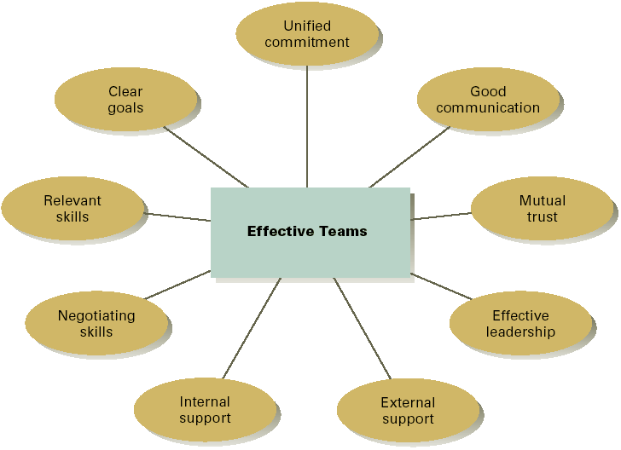
Characteristics of High-performing Work Teams

Slide 13
Stages of Team Development

Slide 14
1. Forming
In this stage, most team members are positive and polite. Some are anxious, as they haven't fully understood what work the team will do. Others are simply excited about the task ahead.
As leader, you play a dominant role at this stage, because team members' roles and responsibilities aren't clear.
This stage can last for some time, as people start to work together, and as they make an effort to get to know their new colleagues.

Slide 15
2. Storming
Next, the team moves into the storming phase, where people start to push against the boundaries established in the forming stage. This is the stage where many teams fail.
Storming often starts where there is a conflict between team members' natural working styles. People may work in different ways for all sorts of reasons but, if differing working styles cause unforeseen problems, they may become frustrated.
Storming can also happen in other situations. For example, team members may challenge your authority, or jockey for position as their roles are clarified. Or, if you haven't defined clearly how the team will work, people may feel overwhelmed by their workload, or they could be uncomfortable with the approach you're using.

Slide 16
2. Storming
Some may question the worth of the team's goal, and they may resist taking on tasks.
Team members who stick with the task at hand may experience stress, particularly as they don't have the support of established processes, or strong relationships with their colleagues.

Slide 17
3. Norming
Gradually, the team moves into the norming stage. This is when people start to resolve their differences, appreciate colleagues' strengths, and respect your authority as a leader.
Now that your team members know one another better, they may socialize together, and they are able to ask one another for help and provide constructive feedback. People develop a stronger commitment to the team goal, and you start to see good progress towards it.
There is often a prolonged overlap between storming and norming, because, as new tasks come up, the team may lapse back into behavior from the storming stage.

Slide 18
4. Performing
The team reaches the performing stage, when hard work leads, without friction, to the achievement of the team's goal. The structures and processes that you have set up support this well.
As leader, you can delegate much of your work, and you can concentrate on developing team members.
It feels easy to be part of the team at this stage, and people who join or leave won't disrupt performance.

Slide 19
5. Adjourning
Many teams will reach this stage eventually. For example, project teams exist for only a fixed period, and even permanent teams may be disbanded through organizational restructuring.
Team members who like routine, or who have developed close working relationships with colleagues, may find this stage difficult, particularly if their future now looks uncertain.

Slide 20
Barriers to Team Building
Credibility of the project leader
Unclear project objectives
Changing goals and priorities
Lack of team definition and structure
Confusion about roles and responsibilities
Excessive team size

Slide 21
Common Characteristics of High Performing Teams
Goals are clearly defined and matched with measurable outcomes
Accurate effective 2-way communication
Leadership is shared and participation encouraged
Effective decision making and problem solving
Team identity and cohesiveness
Diverse backgrounds and experience Cooperation and collaborate

Slide 22
Develop Your Team……??
Be patient and kind with your team
Fix the problem instead of blaming people
Establish regular, effective meetings
Allow time for teams to go through the basic team-building stages
Limit the size of work teams to five to twelve members
Plan some social activities to help project team members and other stakeholders
Stress team identity
Encourage them to help each other

Slide 23
Managing Conflicts Between Teams
Conflict in teams isn't always disadvantageous.
Conflict can benefit teams as it encourages the expression of new ideas.
It can also expose weaknesses in operational procedures and policies and highlight challenges that have the potential to turn into serious problems if ignored.
There are a number of techniques and policies that can be implemented to help you keep things under control.

Slide 24
Managing Conflicts Between Teams
Train staff to resolve conflicts in a professional manner without the intervention of management.
Intervene and act as an objective third party in the dispute. Bring the two parties together and mediate a discussion.
Call a team meeting and explain the problem from the point of view of an objective third-party.
Create a culture where each person’s value is well-known.
Find common ground and rebuild.

Slide 25
Ways to Lead, Inspire and Motivate Your Team
1. Find out what they need?? (Listen to your team their problems and needs)
2. Be respectful.
3. Stop micromanaging
4. Lead by example
5. Be personable (Gone is Gone)
6. Stress your company’s purpose (Remind your objectives)

Slide 26
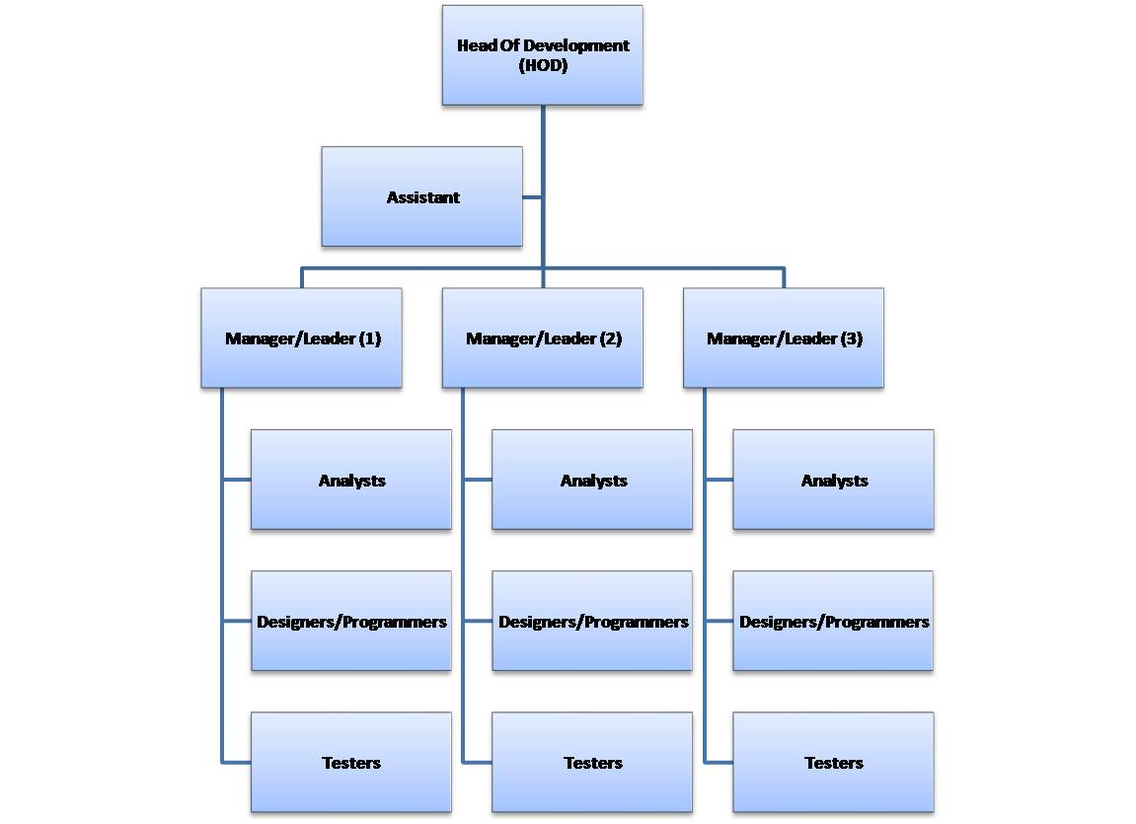

Slide 27


